Slide 1
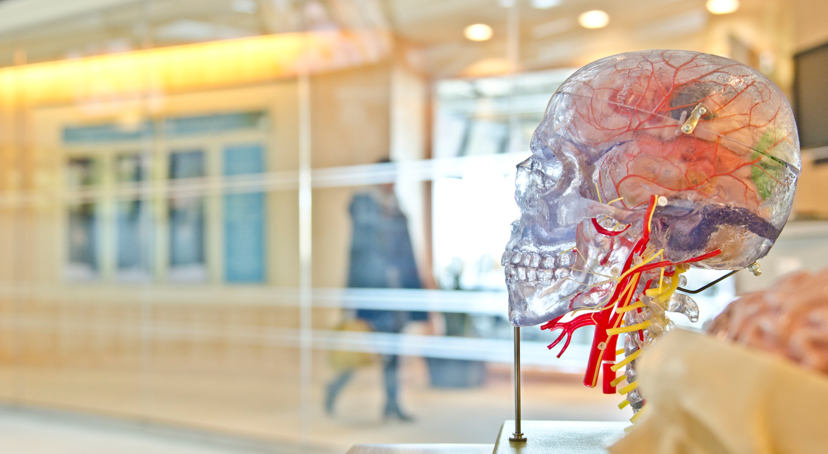
The Adolescent Brain and the Disease of Addiction
Copyright, Overdose Lifeline. Inc.
Notes:
The Brain and the Disease of Addiction. In this course we will learn about the disease of addiction by looking at how the brain is affected by substances such as drugs and alcohol and how the disease of addiction develops.
Presenter / Facilitator Notes:
This is the shortened version of the training which runs 45-60 minutes. Maintain the core learning objectives, lightens some of the detail. 55 slides compared to MASTER’s 73 slides.
When you see italicized text within the slide notes, this is a note for the presenter. It is not part of the script.
There are opportunities for you to customize/add slides for your community. For example: you may add your organization branding and contact information. Include state and local resources, upcoming events, etc. which may be helpful for your attendees, or which are related to the topic of the training.
You will see examples of animations throughout the PPT. This means, graphics and/or text will change, or move on-screen either when you click the mouse (or hit the “next” button), or they are timed to move on their own. Animations have been incorporated to help with attendee attention/engagement, serve up smaller bits of information as we move the attendee down a learning path, and/or include a two-way interaction point (Q&A).
Shortened Version – Updated February 2024

Slide 2
Agenda for the Day
Objectives & Introductions
Defining Addiction & Substance Use Disorder
Setting the Stage
Cause & Risk Factors
Effects on the Brain
Withdrawal
Return to Use or Setback
Neuroplasticity
https://youtu.be/iKjBKDdg6d4

Slide 3
Introductions
Name
Role
What are you hoping to get from today?

Slide 4
Group Agreements
Open to new ideas and concepts
Confidentiality
Respect of differing views
What else?

Slide 5
Question????
Why do you think kids are doing drugs?

Slide 6
Why Do Adolescents Use?
Understanding why adolescents use drugs or alcohol is crucial for effective intervention.
Insights from a recent 30-month study of 923 teenagers receiving outpatient and residential substance abuse treatment provide valuable information.

Slide 7
Setting The Stage
Adolescents, because of the immaturity of impulse control and judgment, are especially prone to experimentation with drug & alcohol use.
Novelty seeking, poor parental supervision, and peer involvement further reinforce the use .
Adolescent autonomy and freedom offer opportunities for use
Teens with ADHD, Conduct Disorder, Trauma history , and school failure are especially at risk
Situations with limited opportunity, easy access to drugs, and routine family and community use amplify the use

Slide 8
Reasons for Initiation
Three-quarters of teens cited social pressures and experimentation as reasons for initiating drug or alcohol use.
Reasons include peer influence, wanting to blend in, spending time with friends, being accepted, becoming popular, enhancing social activities, or fear of alienation.
Curiosity and witnessing use by a parent or relative were also reported motivations.
Only 7% reported initiating use to cope with difficulties.

Slide 9
Reasons for Continuing Use
More than half of teens reported continuing drug use because it feels good (29%) or helps them cope with difficulties (23%).
Another 7% reported addiction or habit, while 4% felt drug or alcohol use enhanced their sense of self.
For teens experiencing traumatic stress, substance use may serve as a coping strategy to deal with stress or avoid negative emotions.

Slide 10
Reasons for Quitting
Among teens who quit using drugs or alcohol, 57% cited adverse effects on their lives as the primary reason.
Reasons include tiredness of using, concern about the effect on the life path, and worry about adverse physical and psychological effects.
External pressures accounted for less than one-quarter of reasons for quitting, including jail, mandated treatment, family/friends, and avoiding trouble.

Slide 11
Consequences
Addiction with associated withdrawal is rare in adolescence. However, other consequences are expected – poor school performance, family conflict, and legal difficulties.
Drug use is indicative of a health-compromising lifestyle
Child development
Household safety
Psychosocial impact
Intergenerational trauma and mental health problems

Slide 12
Specific risks of drug use:
Binge Drinking
Inexperience coupled with impulsivity
Secondary problem – unwanted sexual behavior, rape
Disinhibition
Driving while intoxicated

Slide 13
In-Home Indicators of Potential Parental Substance Use
A report of substance use in the child protective services call or report
Paraphernalia observed or reported in the home
The smell of alcohol, marijuana, or other drugs on the parent or in the home
A child reports use by parent(s) or adults in the home
The parent’s behavior suggests intoxication
The parent exhibits signs of a substance use disorder
Parent reports their substance use
Parent shows or reports experiencing physical effects of a substance use disorder and/or withdrawal.
Note: This list is not meant to include all possible signs.
(Breshears, 2009)
Notes:
The next session of this training discusses possible use or substance use disorder indicators that you need to look for when you conduct a home or on-site visit or investigation:
A report of substance use in the child protective services call or report.
Observations or reports of paraphernalia in the home.
This can include things such as a syringe kit, pipes, a charred spoon, foils, a large number of liquor or beer bottles, etc.
The parent (or the home) smells of alcohol, marijuana, or other drugs (drugs can produce different smells).
A child reports use by parent(s) or other adults in the home.
A parent exhibits physical behavior that suggests that they are under the influence of alcohol or drugs.
This might include slurred speech, an inability to mentally focus, poor physical balance, or extreme lethargy or hyperactivity.
A parent shows signs of a substance use disorder.
Examples include needle tracks, skin abscesses, burns on inside of lips, etc.
A parent reports their own substance use.
A parent shows or reports experiencing physical effects of a substance use disorder, including withdrawal.
Signs of withdrawal include nausea, euphoria, slowed thinking, and hallucinations.
***This list is not meant to be inclusive of all possible signs. Ask participants if they can identify other signs of use.

Slide 14
Effects of Substance Use Disorders on Family Functioning
Child development
Household safety
Psychosocial impact
Parenting skills
Intergenerational trauma and mental health problems
(Smith & Wilson, 2016)
Notes:
The life of a person with a substance use disorder is often out of balance, and the negative effects of use and misuse can have an enormous impact on his or her family and friends. The following shows how substance use disorders negatively affect a family’s functioning across several domains.
Child Development
Children may present with fetal alcohol syndrome or have a history of neonatal abstinence syndrome. Infants exposed to substances may experience a range of social, emotional, and behavioral effects as a result of exposure.
Household Safety
Parents may neglect a child’s basic needs (e.g., empty cupboards, no adult supervision). Parental use may include manufacturing substances or selling drugs. Children may be exposed to harsh chemicals (i.e., those used in methamphetamine labs) or to dangerous and traumatic situations.
Psychosocial Impact
Children may struggle with communication difficulties, overstimulation, or emotional regulation. The postnatal environment may contribute to insecure attachment or other social-emotional concerns.
Parenting
Parent-child relationships may lack trust. Children may feel as though they must be the parent, resulting in feelings of anxiety and stress.
Parents may lack the skills to parent effectively, due to their own history as children of substance users.
Parent may use harsh discipline.
Intergenerational
Multiple generations of the family may be affected by substance use disorders.
Parents may lack basic family support, due to generational substance use disorders.
The family may present with issues of chronic neglect, due to the effects of long-term substance use disorders.

Slide 15
Parental substance use affects the whole family
Developmental effect
Psycho-social effects
Effect on parenting
Generational effects
Notes:
This slide summarizes the ways that parental substance use can affect the family.
***Review highlights from the previous slides and ask participants if they have any other examples of effects of parental substance use on the family.

Slide 16
section 01 Defining Addiction and Substance Use Disorder
Copyright, Overdose Lifeline. Inc.
Notes:
Defining Addiction and Substance Use Disorder
https://www.youtube.com/watch?v=iKjBKDdg6d4

Slide 17
Advancements in Addiction/SUD
1950s
1994
Scientist began to understand addiction as a brain disorder. Olds and Milner studies of rats located the parts of the brain affected.
Neuroscientists Volkow and Schelbert showed the effects of substance use disorders through PET scans of the brain.
1960s
1980s
Today
Insurance industry begins to reimburse the treatment of alcoholism. AMA identifies alcoholism as a complex disease, to be addressed by all members in health professions.
Researchers and medical professionals began studying the ways that addiction and mental health issues interact with each other.
It has been nearly 70 years since the science and medical community have defined addiction as a chronic brain disease. Still today, many think it is a moral failing.
Sources: NCADD, Inc. and Crocq
Notes:
Some of the more notable historical marks in Addiction and Substance Use Disorder advancements
In the 1950s, scientist began to understand addiction as a brain disorder. Olds and Milner studies of rats located the parts of the brain affected.
In the 1960s, the insurance industry begins to reimburse the treatment of alcoholism. The American Medical Association (A M A) identifies alcoholism as a complex disease, to be addressed by all members in health professions.
In the 1980’s, Researchers and medical professionals began studying the ways that addiction and mental health issues interact with each other.
In 1994, neuroscientists Volkow and Schelbert showed the effects of substance use disorders through PET scans of the brain.
And today … there is more research underway and education needed. It has been nearly 70 years since the science and medical community have defined addiction as a chronic brain disease. Still today, many think it is a moral failing.
Sources: Crocq, Historical and cultural aspects of man's relationship with addictive drugs, Dec 2007, and White, W., Slaying the Dragon: The History of Addiction Treatment and Recovery in America, Mar, 1998.

Slide 18
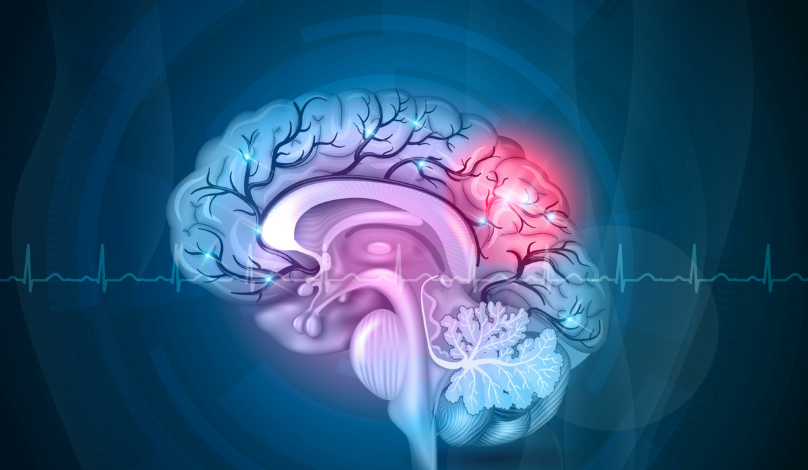
Addiction is a chronic brain disease. Like other diseases, addiction should be treated medically.
OverdoseLifeline.org
Copyright 2017 Overdose Lifeline, Inc.
Source: NIDA, (2016)
Notes:
Addiction (or substance use disorder) is not a choice, and it’s not due to a of lack of willpower. Addiction is a CHRONIC BRAIN DISEASE -- that can be compared to other chronic diseases like diabetes, heart disease, and high blood pressure. In the case of addiction, the brain is the organ which is impacted.
Chronic diseases generally cannot be prevented by vaccines, nor do they just go away on their own. However, with appropriate treatment, often including medication, many chronic diseases can be managed such that their symptoms do not impact a person’s health and functioning.
Source: National Institute of Drug Abuse: The Science of Drug Abuse and Addiction, Updated August 2016
ANIMATIONS ARE TIMED TO APPEAR ON SCREEN WITHOUT NEED FOR MOUSE CLICK

Slide 19
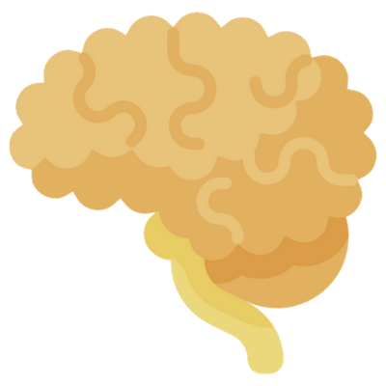
Addiction Definition
Addiction is a treatable, chronic medical disease involving complex interactions among brain circuits, genetics, the environment, and an individual’s life experiences.
Substance use and behaviors become compulsive and often continues despite harmful consequences.
Source: American Society of Addiction Medicine (ASAM ) 2019
Notes:
From the American Society of Addiction Medicine (or ASAM)
Addiction is a treatable, chronic medical disease involving complex interactions among brain circuits, genetics, the environment, and an individual’s life experiences.
[CLICK MOUSE]
People with addiction use substances or engage in behaviors that become compulsive and often continue despite harmful consequences.
Source: American Society of Addiction Medicine (ASAM ) 2019, https://www.asam.org/quality-practice/definition-of-addiction

Slide 20
Addiction Definition
Addiction is a treatable, chronic medical disease involving complex interactions among brain circuits, genetics, the environment, and an individual’s life experiences.
Prevention efforts and treatment approaches are generally as successful as those for other chronic diseases.
Source: American Society of Addiction Medicine (ASAM ) 2011
Notes:
Prevention efforts and treatment approaches for addiction are generally as successful as those for other chronic diseases.
Source: American Society of Addiction Medicine (ASAM), Definition of Addiction, September 2019. https://www.asam.org/resources/definition-of-addiction
ANIMATIONS ARE TIMED TO APPEAR ON SCREEN WITHOUT NEED FOR MOUSE CLICK

Slide 21
Addiction Definition
Addiction is characterized by:
Inability to Consistently Abstain
Craving
Dysfunctional Emotional Response
Behavioral Control Impairment
Diminished Awareness of Behavior & Relationship Problems
Source: American Society of Addiction Medicine (ASAM )
Notes:
Addiction is characterized by inability to consistently abstain,
[CLICK MOUSE]
impairment in behavioral control,
[CLICK MOUSE]
craving,
[CLICK MOUSE]
diminished recognition, or awareness, of significant problems with one’s behaviors and interpersonal relationships, and a
[CLICK MOUSE]
dysfunctional emotional response.
Source: American Society of Addiction Medicine (ASAM), Definition of Addiction, September 2019. https://www.asam.org/resources/definition-of-addiction

Slide 22
Addiction Definition
Like other chronic diseases, addiction often involves cycles of setback and remission.
Without treatment or engagement in recovery activities, SUD is progressive and can result in disability or premature death.
Source: American Society of Addiction Medicine (ASAM )
Notes:
Like other chronic diseases, addiction often involves cycles of setback and remission.
Without treatment or engagement in recovery activities, addiction is progressive and can result in disability or premature death.
Source: American Society of Addiction Medicine (ASAM ) 2019, https://www.asam.org/quality-practice/definition-of-addiction
ANIMATION IS TIM.ED TO APPEAR WITHOUT NEED FOR “CLICKING MOUSE”

Slide 23
Addiction Definition
Addiction involves cycles of setback and remission.
Is progressive, can result in disability or premature death.
Source: American Society of Addiction Medicine (ASAM )
Notes:
Like other chronic diseases, addiction often involves cycles of setback and remission. Without treatment or engagement in recovery activities,
[CLICK MOUSE]
addiction is progressive and can result in disability or premature death.
Source: American Society of Addiction Medicine (ASAM), Definition of Addiction, September 2019. https://www.asam.org/resources/definition-of-addiction

Slide 24
Continuum of substance use
No Use
Experimental or Situational
Chaotic / Persistent
Social
Habitual / Daily
Regular Use
Ritual Binge
Source: Jeannie Little, LCSW, CGP What's Under the Harm Reduction Umbrella?, The Fix, May 2015
Notes:
Substance use occurs on a continuum from no use to benign use to chaotic use, with many points in between.
The continuum of substance use includes:
No use
Experimental or Situational
Social
Regular use
Ritual Binge
Habitual / Daily
Chaotic / Persistent
Source: Jeannie Little, LCSW, CGP What's Under the Harm Reduction Umbrella?, The Fix, May 2015

Slide 25
Continuum of substance use Harms can occur at any point and should be addressed, regardless of where the person is on the continuum.
No Use
Experimental or Situational
Chaotic / Persistent
A person can move back and for within the continuum, it’s not just a one-way path
Social
Habitual / Daily
Regular Use
Ritual Binge
Source: Jeannie Little, LCSW, CGP What's Under the Harm Reduction Umbrella?, The Fix, May 2015
Notes:
Some additional notes:
The continuum of substance use is not linear.
A person can move back and forth within the continuum, its not just a one-way path.
For example, starting at the experimental stage does not automatically lead to the other end of the continuum.
Source: Jeannie Little, LCSW, CGP What's Under the Harm Reduction Umbrella?, The Fix, May 2015

Slide 26
Continuum of substance use Harms can occur at any point and should be addressed, regardless of where the person is on the continuum.
No Use
Experimental or Situational
Chaotic / Persistent
People can be at different points of the continuum for different substances
Social
Habitual / Daily
Regular Use
Ritual Binge
Source: Jeannie Little, LCSW, CGP What's Under the Harm Reduction Umbrella?, The Fix, May 2015
Notes:
People can also be at different points for different substances. This is important to acknowledge, there are multiple pathways to recovery.
Example: some people may want to abstain from a substance that is problematic, but still use something that is social or something that helps them through regular use that’s not chaotic.
Source: Jeannie Little, LCSW, CGP What's Under the Harm Reduction Umbrella?, The Fix, May 2015

Slide 27
Continuum of substance use Harms can occur at any point and should be addressed, regardless of where the person is on the continuum.
No Use
Experimental or Situational
Chaotic / Persistent
Traditional notions of recovery do not always make space for this option which can cause more challenges for individuals.
Social
Habitual / Daily
Regular Use
Ritual Binge
Source: Jeannie Little, LCSW, CGP What's Under the Harm Reduction Umbrella?, The Fix, May 2015
Notes:
Traditional notions of recovery do not always make space for this option which can cause more challenges for individuals.
Source: Jeannie Little, LCSW, CGP What's Under the Harm Reduction Umbrella?, The Fix, May 2015

Slide 28
Addiction Video
https://www.youtube.com/watch?v=Epc5JLKPMmw

Slide 29
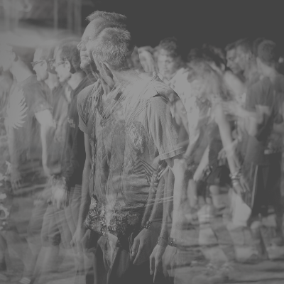
How many Americans are affected?
23 Million
Living in Recovery
(non-symptomatic)
43 MILLION AMERICANS AFFECTED
20 Million
Symptomatic
Source: Substance Abuse and Mental Health (SAMHSA), 2018
Notes:
An estimated 20 million Americans are symptomatic, or their disease is active.
[CLICK MOUSE]
Another estimated 23 million Americans are living in recovery from addiction.
Recovery means that a person is no longer active in their addiction – they are non-symptomatic, have improved health, wellness, and quality of life.
[CLICK MOUSE]
When we combine these two – 43 million Americans are affected.
Source: Substance Abuse and Mental Health Services Association, SAMHSA, 2019 National Survey of Drug Use and Health (NSDUH) (HHS Publication No. PEP20-07-01-001, NSDUH Series H-55), September 2020.
Note: We are not referencing the 2020 or 2021 NSDUH studies as data collection was impacted due to the pandemic. We expect to update the source when the 2022 NSDUH is published.
ANIMATIONS ARE TIMED TO APPEAR ON SCREEN WITHOUT NEED FOR MOUSE CLICK

Slide 30
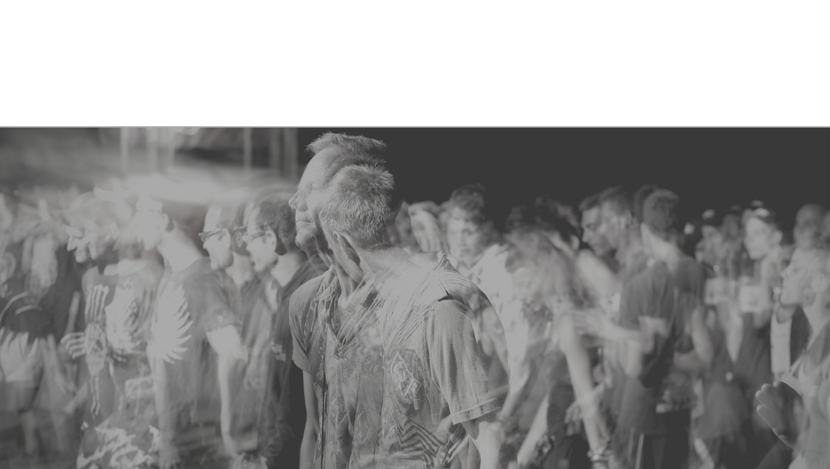
Treatment Barriers
Only 1 in 10 Receive Treatment
OverdoseLifeline.org
Notes:
Yet only 1 in 10 people with addiction receive treatment. This treatment gap leaves millions without the proper treatment.
ANIMATIONS ARE TIMED TO APPEAR ON-SCREEN WITHOUT NEED TO [CLICK MOUSE]
Sources: Hoge, Mental Health and Addiction Workforce Development: Federal Leadership Is Needed To Address The Growing Crisis, Health Affairs Journal, November 2013 vol. 32.

Slide 31
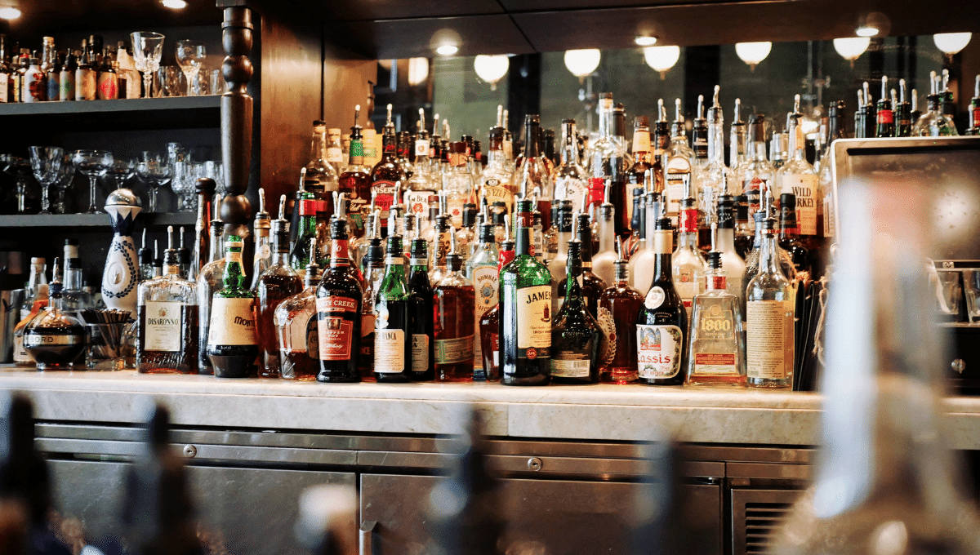
Alcohol Use Disorder
14.8 million Americans
Source: Substance Abuse and Mental Health Services Administration (SAMHSA)
OverdoseLifeline.org
Notes:
Alcohol use disorder is the largest SUD affecting 14.8 million Americans.
Source: Substance Abuse and Mental Health Services Association SAMHSA 2018 National Survey on Drug Use and Health, August 2019
ANIMATIONS ARE TIMED TO APPEAR ON-SCREEN WITHOUT NEED TO [CLICK MOUSE]

Slide 32
53 Million Illicit Drug Use - 2018
Marijuana 43.5 million
RX Opioids 9.9 million
RX Tranquilizers 6.4 million
Hallucinogens 5.6 million
Inhalants 2.0 million Methamphetamine 1.9 million Heroin 808,000
Cocaine 5.5 million
RX Stimulants 5.1 million
Source: Substance Abuse and Mental Health Services Administration (SAMHSA)
Notes:
More than 53 million Americans reported using an Illicit drug in 2018.
Marijuana 43.5 million – which was an increase over past year
[CLICK MOUSE]
Prescription Opioids 9.9 million – which was lower than the past year
[CLICK MOUSE]
Prescription Tranquilizers, with the majority being benzodiazepines 6.4 million – which was similar to the past year
[CLICK MOUSE]
Hallucinogens 5.6 million – which was similar to the past year
[CLICK MOUSE]
Cocaine, including Crack Cocaine 5.5 million – which was similar to the past year
[CLICK MOUSE]
RX Prescription Stimulants 5.1 million – which was lower than the past year
[CLICK MOUSE]
The last three were all at similar rates to the last year:
Inhalants 2.0 million
Methamphetamines 1.9 million
And Heroin 808,000
Source: Substance Abuse and Mental Health Services Association SAMHSA 2018 National Survey on Drug Use and Health, August 2019

Slide 33
Treatment Barriers
Of the 20 million people who needed treatment for an illicit drug or alcohol use problem, only 2.1 million received substance use treatment. Few who have a need get access.
AVAILBILITY Treatment Programs
HIGH COSTS Treatment Services
LACK
Insurance
TRAVEL TIME
Outpatient Treatments
Notes:
Of the 20 million people who needed treatment for an illicit drug or alcohol use problem, only 2.3 million received substance use treatment. Few who have a need get access.
Availability of evidence-based treatment programs – prior to the health crisis, Indiana ranked low nationally for availability of treatment. This health crisis is straining the limited programs across the state. We are well behind
High Costs of treatment services
Often, there is a Lack of Insurance Coverage, or suitable coverage for a chronic disease.
Travel time for outpatient treatments is a barrier across Indiana’s rural communities.
Source: Substance Abuse and Mental Health Services Association (SAMHSA), 2018 National Survey of Drug Use, August 2019

Slide 34
Stigma often causes people with addiction to become so embarrassed or ashamed that they conceal symptoms—and avoid seeking the very treatment, services, and support they need and deserve.
Source: SAMHSA, (2006).
Notes:
Worst of all, stigma often causes people with addiction to become so embarrassed or ashamed that they conceal symptoms—and avoid seeking the very treatment, services, and supports they need and deserve.
Source: Substance Abuse and Mental Health Services Administration. Developing a Stigma Reduction Initiative. SAMHSA Pub No. SMA-4176, 2006.

Slide 35
Family and loved one’s experience stigma. Hesitate to take action, to ask for help. They carry guilt and shame – affecting their health and wellness.
Source: SAMHSA, (2006).
Notes:
Family and loved one’s experience stigma-by-association. Due to this they may be hesitant to take action, to ask for help. They carry guilt and shame. Affecting their own health and wellness.
Source: Substance Abuse and Mental Health Services Administration. Developing a Stigma Reduction Initiative. SAMHSA Pub No. SMA-4176, 2006.

Slide 36
With SUD the sooner you intervene, the better the outcome—yet stigma causes patients and families to keep the disease a secret for fear of being judged and marginalized.
Source: SAMHSA, (2006).
Notes:
As with many chronic diseases - the sooner you intervene, the better the outcome—yet stigma causes patients and families to keep the disease a secret for fear of being judged and marginalized.
Source: Substance Abuse and Mental Health Services Administration. Developing a Stigma Reduction Initiative. SAMHSA Pub No. SMA-4176, 2006.

Slide 37
Language
Research shows that the language we use to describe [addiction] can either perpetuate or overcome the stereotypes, prejudice and lack of empathy that keep people from getting treatment they need.
- Michael Botticelli, leading addictions expert and former Director of the White House Office of National Drug Control Policy
Source: Fraser, (2016).
Notes:
Words matter and continued use of stigmatizing language perpetuates false stereotypes, spreads misinformation, and keeps people out of care.
"Research shows that the language we use to describe [addiction] can either perpetuate or overcome the stereotypes, prejudice and lack of empathy that keep people from getting treatment they need."
- Michael Botticelli, leading addictions expert and former Director of the White House Office of National Drug Control Policy

Slide 38
Language examples
Addiction is the preferred term. Substance Use Disorder is also applicable and preferred by some health professionals.
Avoid using negative terms like addict, user, abuser, junkie - all of which sensationalize the disease. Instead, choose phrasing like he was addicted, people with opioid addiction, or he was using drugs.
Avoid terms like ‘abuse’ or ‘problem’ which imply judgement, in favor of the word use. In some cases, misuse is also acceptable.
Instead of saying ‘relapsed,’ say had a ‘setback’, ‘return to use’, or incident of use’.
Source: Recovery Research Institute
Notes:
Addiction is the preferred term. Substance Use Disorder is also applicable and
preferred by some health professionals.
[CLICK MOUSE]
Avoid using negative terms like addict, user, abuser, junkie - all of which sensationalize
the disease - unless they are in quotations. Instead, choose
phrasing like he was addicted, people with opioid addiction, or he was using drugs.
[CLICK MOUSE]
We must avoid terms like ‘abuse’ or ‘problem’ which imply judgement of the person, in
favor of the word use. In some cases, misuse is also acceptable.
[CLICK MOUSE]
Instead of saying ‘relapsed,’ say had a ‘setback’, ‘return to use’, or incident of use’.
Source: Recovery Research Institute, Words Matter: How we describe individuals with substance problems affects perceptions, https://www.recoveryanswers.org/research-post/how-we-describe-individuals-substance-problems-affects-perceptions/ Accessed July 2019

Slide 39
section 02 Cause and Risk Factors
Copyright, Overdose Lifeline. Inc.
Notes:
Cause and Risk Factors
This section of the course will review the risk factors or causes of addiction / substance use disorder.

Slide 40
https://www.youtube.com/watch?v=eVLpnMHHEPU

Slide 41
As with other diseases, vulnerability to the disease of addiction varies from individual to individual.
Source: National Institute on Drug Abuse (NIDA)
Notes:
As with other diseases, vulnerability to the disease of addiction varies from individual to individual.
Not one single factor, but several factors contribute to the development of addiction.
Source: National Institute of Drug Abuse, Drugs, Brains, and Behavior: The Science of Addiction https://www.drugabuse.gov/publications/drugs-brains-behavior-science-addiction/drug-abuse-addiction, Accessed July 2019.
ANIMATIONS ARE TIMED TO APPEAR ON-SCREEN WITHOUT NEED TO [CLICK MOUSE]

Slide 42
Cause and Risk Factors
Mental Disorders
Biological Sex
Genetics
Biological
The main factors fall within two categories: Biological and Environmental
Environmental
Home Environment, History
Of Trauma or Abuse
Family’s Use and Attitudes
Peer Influences
Community Attitudes
Low Academic Achievement
Source: National Institute on Drug Abuse (NIDA)
Notes:
The main factors fall within two categories: Biological and Environmental.
[CLICK MOUSE]
Environmental factors include home environment and history of trauma or abuse, family’s use, beliefs and attitudes. Exposure to a peer group that encourages drug use, community attitudes, and low academic achievement.
[CLICK MOUSE]
Once you've started using a drug, the development into addiction may be influenced by Biological traits such as genetics, biological sex, or mental disorders, which may delay or speed up the disease progression.
Source: https://www.drugabuse.gov/publications/drugs-brains-behavior-science-addiction/drug-abuse-addiction, last update July 2014.

Slide 43
Cause and Risk Factors
Mental Disorders
Biological Sex
Genetics
Early Use
Biological
Substance/Drug
Environmental
Route of Administration
Home Environment, History
Of Trauma or Abuse
Effect of the Drug
Family’s Use and Attitudes
Cost
Peer Influences
Availability
Community Attitudes
Low Academic Achievement
Source: National Institute on Drug Abuse (NIDA)
Notes:
Early use of a substance or drug increases one’s risk factor. Research shows that the earlier a person begins to use drugs, the more likely he or she is to develop serious problems.
[CLICK MOUSE]
How the substance is administered – or the route in which the substance is used – increases the risks. Smoking a drug or injecting a drug will increase the drugs addictive potential due to the speed of the substance reaching and affecting the brain.
The substance itself also has an effect. Drugs such as Cocaine, Methamphetamine, Nicotine, Opioids and alcohol have a higher addiction rate due to their effects on the brain mechanisms. Finally, the lower the cost and the availability of the substance will affect the individual risk factors.
Source: https://www.drugabuse.gov/publications/drugs-brains-behavior-science-addiction/drug-abuse-addiction, last update July 2014.

Slide 44
Cause and Risk Factors
Mental Disorders
Biological Sex
Genetics
Early Use
Biological
Substance/Drug
Environmental
SUD
Route of Administration
Home Environment, History
Of Trauma or Abuse
Effect of the Drug
Family’s Use and Attitudes
The more risk factors, the greater the chance this will lead to changes in the brain mechanism, leading to addiction/SUD.
Cost
Peer Influences
Availability
Community Attitudes
Low Academic Achievement
Source: National Institute on Drug Abuse (NIDA)
Notes:
In general, the more risk factors a person has, the greater the chance that taking drugs/using alcohol will lead to changes in the brain mechanism, leading to addiction/substance use disorder.
Source: https://www.drugabuse.gov/publications/drugs-brains-behavior-science-addiction/drug-abuse-addiction, last update July 2014.
ANIMATIONS ARE TIMED TO APPEAR ON-SCREEN WITHOUT NEED TO [CLICK MOUSE]

Slide 45
Age and risk of developing SUD
The majority started using before age 18 and developed their disorder by age 20.
Source: National Institute on Drug Abuse (NIDA)
Notes:
The majority of those who have a substance use disorder started using before age 18 and developed their disorder by age 20.
Source: National Institute of Drug Abuse, Drugs, Brains, and Behavior: The Science of Addiction https://www.drugabuse.gov/publications/drugs-brains-behavior-science-addiction/drug-abuse-addiction, Accessed July 2019.
ANIMATIONS ARE TIMED TO APPEAR ON-SCREEN WITHOUT NEED TO [CLICK MOUSE]

Slide 46
Age and risk of developing SUD
Risk greater for those who begin in early teens.
15.2% who started drinking by age 14, developed alcohol use disorder, compared to just 2.1% who wait until 21 years or older.
Source: National Institute on Drug Abuse (NIDA)
Notes:
The likelihood of developing a substance use disorder is greatest for those who begin use in their early teens – prior to the brain’s full development during the early to late 20’s.
[CLICK MOUSE]
For example, 15.2 percent of people who start drinking by age 14 eventually develop alcohol use disorder—as compared to just 2.1 percent of those who wait until they are 21 or older.
Source: National Institute of Drug Abuse, Drugs, Brains, and Behavior: The Science of Addiction https://www.drugabuse.gov/publications/drugs-brains-behavior-science-addiction/drug-abuse-addiction, Accessed July 2019.

Slide 47
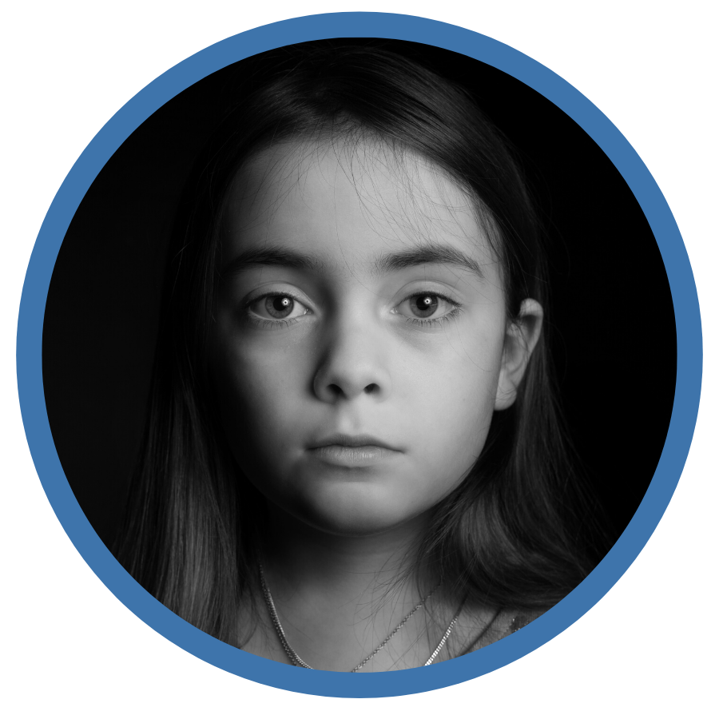
Trauma and Risk of Developing SUD
Adverse Childhood Experiences (ACE) have a profound effect on health, functioning and addiction over the course of a lifetime.
Risk for addiction, other health problems and suicide all go up with each adverse event.
Source: Centers for Disease Control (CDC)
Notes:
Research shows that adverse childhood experiences (or ACE) have a profound effect on health, functioning and addiction over the course of a lifetime. The ACE study is a large longitudinal study now co-sponsored by Kaiser Permanente and the Center for Disease Control (or CDC).
The ACE test asks about ten types of negative childhood experiences and then tracks health outcomes.
[CLICK MOUSE]
Risk for addiction, other health problems and suicide all go up with each adverse event.
Source: Centers for Disease Control, (CDC) Adverse Childhood Experiences https://www.cdc.gov/violenceprevention/childabuseandneglect/acestudy/about.html, Accessed July 2019

Slide 48
Experience Four or More Traumatic Events
Trauma #1
Trauma #4
40-50% Increased Risk of Depression Disorders
46X’s More Likely
IV Drug User
Trauma #3
Trauma #2
5X’s More Likely
Develop Alcohol Use Disorder
Source: Centers for Disease Control (CDC)
Notes:
A child who experiences four or more traumatic events is
[CLICK MOUSE]
five times more likely to develop alcohol use disorder,
[CLICK MOUSE]
40-50% Increased Risk of Depression Disorders
[CLICK MOUSE]
and up to 46 times more likely to become an injection-drug user (or IV drug user) than the general population.
Source: Centers for Disease Control and Prevention, Adverse Childhood Experiences (ACEs) https://www.cdc.gov/violenceprevention/aces/index.html accessed September 2022. Hughes et al, The effect of multiple adverse childhood experiences on health, August 1, 2017, DOI: https://doi.org/10.1016/S2468-2667(17)30118-4

Slide 49
section 03 Effects on the Brain
Copyright, Overdose Lifeline. Inc.
Notes:
Effects on the Brain
This section of the course will look at the effects on the brain from substances such as drugs and alcohol.

Slide 50
Video Overview
https://www.youtube.com/watch?v=PhnPS1hKf_8

Slide 51
There are differences between those who use substances and those with Substance Use Disorder.
Source: National Institute of Drug Abuse
Notes:
We used to think addiction was a moral failing. But there is a growing body of research showing that there are differences between those who use substances and those with addiction.
Source: National Institute of Drug Abuse: The Science of Drug Abuse and Addiction, Updated August 2016

Slide 52
Addiction suggests a more severe turning point where changes in the brain occur.
Source: National Institute of Drug Abuse
Notes:
One can be mentally dependent on things, but addiction suggests a more severe turning point where changes in the brain occur.
Source: National Institute of Drug Abuse: The Science of Drug Abuse and Addiction, Updated August 2016

Slide 53
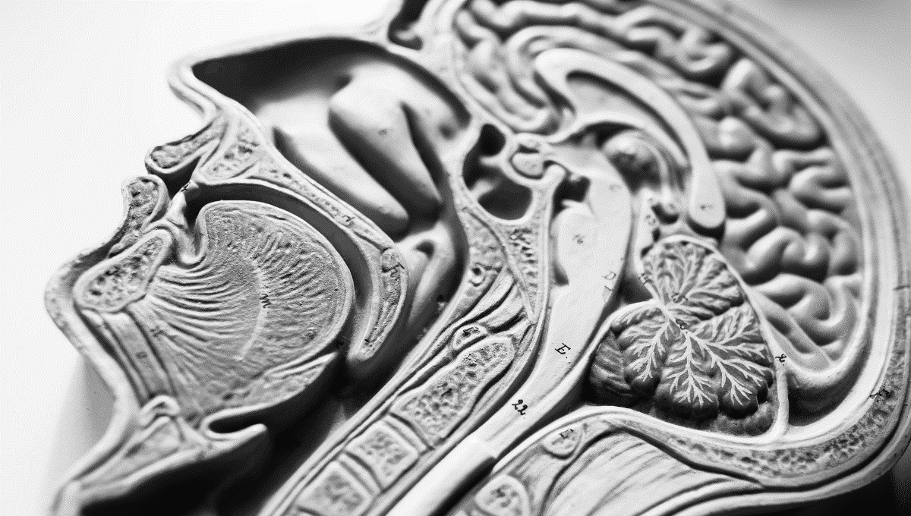
Addiction changes both the brain structure and function.
What began as a choice, is hardwired as CRITICAL for our survival.
OverdoseLifeline.org
Copyright, Overdose Lifeline. Inc.
Source: National Institute of Drug Abuse
Notes:
Addiction changes both the brain structure and function. What began as a choice, is hardwired as CRITICAL for our survival.
Source: National Institute of Drug Abuse: The Science of Drug Abuse and Addiction, Updated August 2016
ANIMATIONS ARE TIMED TO APPEAR ON-SCREEN WITHOUT NEED TO [CLICK MOUSE]

Slide 54
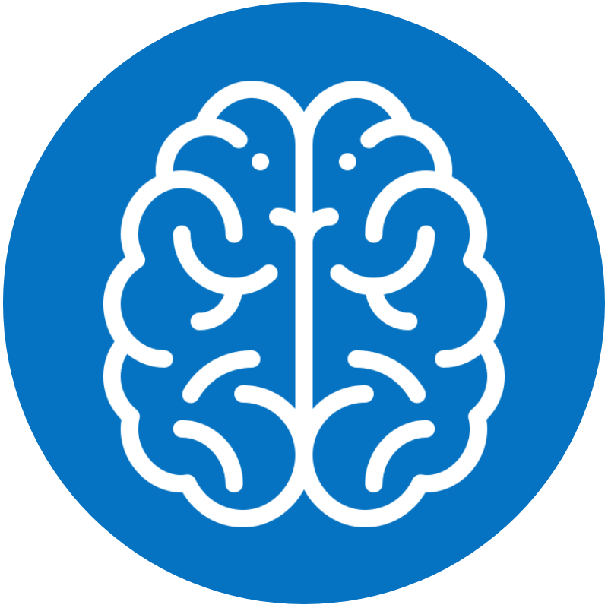
Limbic System and the Reward Pathway
The Brain’s Reward Pathway drives our feelings of motivation, reward and behavior.
Ensures that we will repeat behaviors which are necessary for survival.
BRAIN’S REWARD PATHWAY
Source: The Science of Addiction: Genetics and the Brain, Genetic Science Learning Center. University of Utah 2016
Notes:
Within the Limbic System is the Brain’s Reward Pathway.
The main job of the brain’s reward pathway is to help us avoid painful/harmful experiences and to make us feel good when we engage in behaviors that are necessary for our survival. The reward pathway connects to other areas of our brain to collect information and to communicate information that results in our behavior.
Source: The Science of Addiction: Genetics and the Brain, Genetic Science Learning Center. 2016. University of Utah. April 2016 http://learn.genetics.utah.edu/content/addiction/

Slide 55
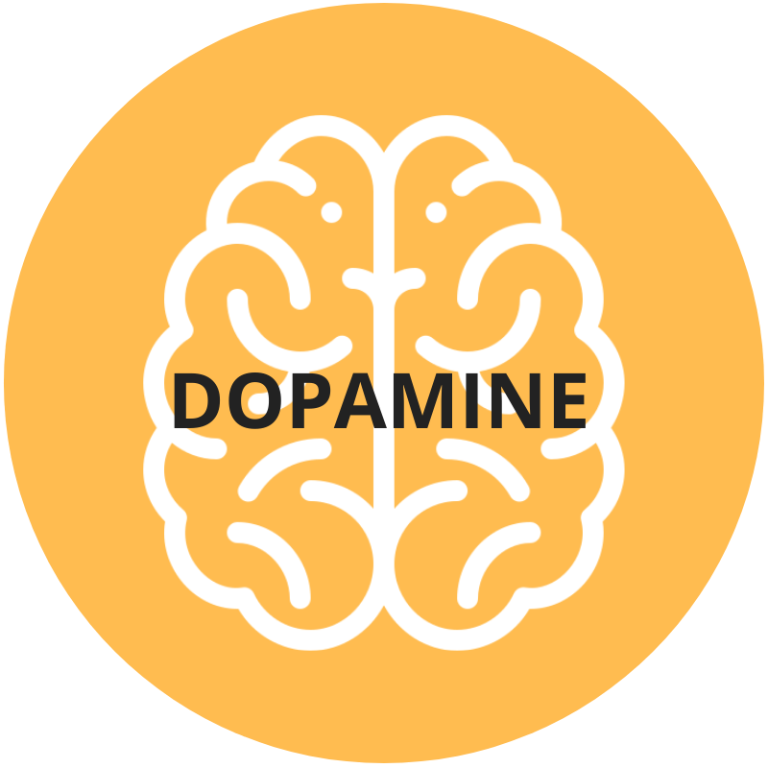
Our brain decides what behaviors to do based on motivation which is driven by a brain chemical called dopamine.
Released when something is “good” and important for our survival
Source: National Institute on Drug Abuse (NIDA) and The Science of Addiction, University of Utah
Notes:
Our brain decides what behaviors to do based on motivation which is driven by a brain chemical (or neurotransmitter) called dopamine. Neurotransmitters control communication throughout our body and brain and react differently to various drugs.
[CLICK MOUSE]
Dopamine is released when it recognizes that something is “good” and important for our survival. Dopamine causes us to experience pleasure, it’s the Brain telling us…
This is good for you. It’s important for your survival. Do this again.
Sources: National Institute of Drug Abuse: Drugs, Brains, and Behavior: The Science of Addiction, https://www.drugabuse.gov/publications/drugs-brains-behavior-science-addiction/drugs-brain, accessed July 2019and The Science of Addiction: Genetics and the Brain, Genetic Science Learning Center. 2016. University of Utah. April 2016 http://learn.genetics.utah.edu/content/addiction/
ANIMATIONS ARE TIMED TO APPEAR ON-SCREEN WITHOUT NEED TO [CLICK MOUSE]

Slide 56
Dopamine also plays a role in…
Behaviors
Learning
Memory
Three KEY elements in the transition from liking something to being addicted to it.
Source: National Institute on Drug Abuse (NIDA) and The Science of Addiction, University of Utah
Notes:
Dopamine not only contributes to the experience of pleasure, but also plays a role in behaviors, learning, and memory—three key elements in the transition from liking something to becoming addicted to it.
Sources: National Institute of Drug Abuse: Drugs, Brains, and Behavior: The Science of Addiction, https://www.drugabuse.gov/publications/drugs-brains-behavior-science-addiction/drugs-brain, accessed July 2019and The Science of Addiction: Genetics and the Brain, Genetic Science Learning Center. 2016. University of Utah. April 2016 http://learn.genetics.utah.edu/content/addiction/
ANIMATIONS ARE TIMED TO APPEAR ON-SCREEN WITHOUT NEED TO [CLICK MOUSE]

Slide 57
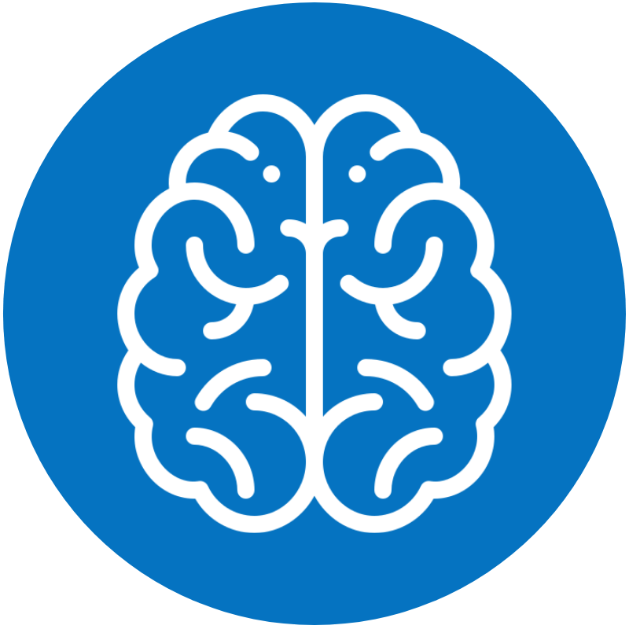
Substances Flood the Brain with Dopamine
Drugs release an incredible amount of dopamine at far greater levels than other activities such as eating or drinking.
dopamine
dopamine
dopamine
dopamine
dopamine
Source: National Institute on Drug Abuse (NIDA) and The Science of Addiction, University of Utah
Notes:
Drugs release an incredible amount of dopamine at far greater levels than other activities such as eating or drinking. Flooding our brain.
The initial decision to take drugs is typically voluntary.
Sources: National Institute of Drug Abuse: Drugs, Brains, and Behavior: The Science of Addiction, https://www.drugabuse.gov/publications/drugs-brains-behavior-science-addiction/drugs-brain, accessed July 2019and The Science of Addiction: Genetics and the Brain, Genetic Science Learning Center. 2016. University of Utah. April 2016 http://learn.genetics.utah.edu/content/addiction/
ANIMATIONS ARE TIMED TO APPEAR ON-SCREEN WITHOUT NEED TO [CLICK MOUSE]

Slide 58
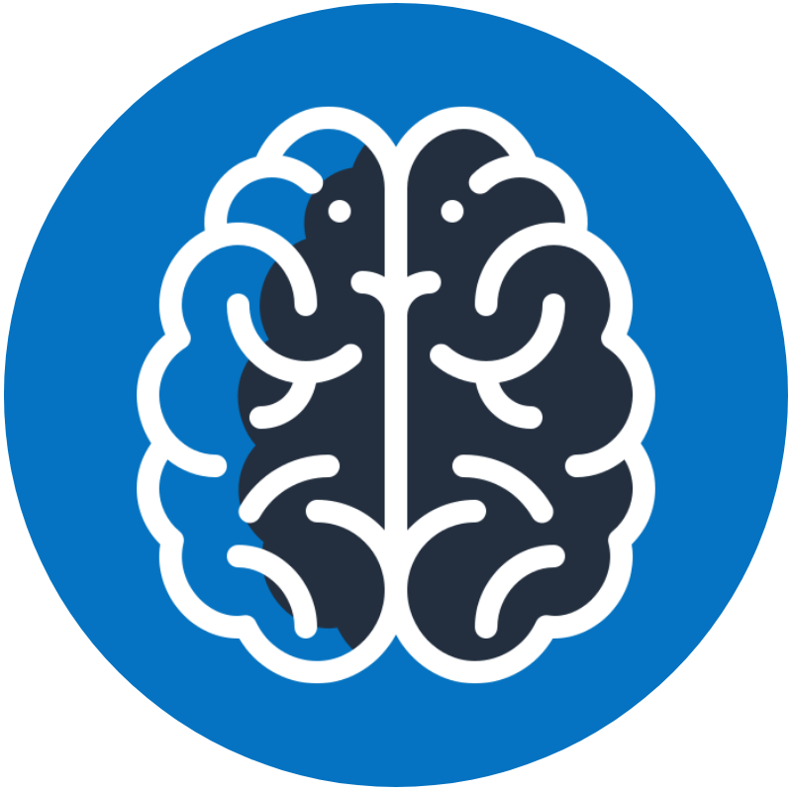
​Reliance – Tolerance – Self-Control
With continued use, the brain makes less dopamine naturally, relying on and needing the drug to get the same effect.
The ability to exert self-control can become seriously impaired.
Source: The Science of Addiction: Genetics and the Brain, Genetic Science Learning Center. University of Utah 2016
Notes:
However, with continued use, the brain makes less dopamine naturally, relying on and needing more of the drug to get the same effect. This is called “Reliance” and “Tolerance”.
[CLICK MOUSE]
The ability to exert self-control can become seriously impaired; this impairment in self-control is the hallmark of addiction.
Source: The Science of Addiction: Genetics and the Brain, Genetic Science Learning Center. 2016. University of Utah. April 2016 http://learn.genetics.utah.edu/content/addiction

Slide 59
Over time, substance use changes the brain
Areas of the brain physically change, and certain behaviors are “hard-wired.”
Before
After
Source: National Institute on Drug Abuse (NIDA) and The Science of Addiction, University of Utah
Notes:
As the brain continues to adapt to the substance, areas outside of the reward pathway are also affected.
[CLICK MOUSE]
Over time, areas of our brain responsible for decision-making, judgment, learning and memory physically change, and certain behaviors are altered. “hard-wired”.
Sources: National Institute of Drug Abuse: Drugs, Brains, and Behavior: The Science of Addiction, https://www.drugabuse.gov/publications/drugs-brains-behavior-science-addiction/drugs-brain, accessed July 2019and The Science of Addiction: Genetics and the Brain, Genetic Science Learning Center. 2016. University of Utah. April 2016 http://learn.genetics.utah.edu/content/addiction/
ANIMATIONS ARE TIMED TO APPEAR ON-SCREEN WITHOUT NEED TO [CLICK MOUSE]

Slide 60
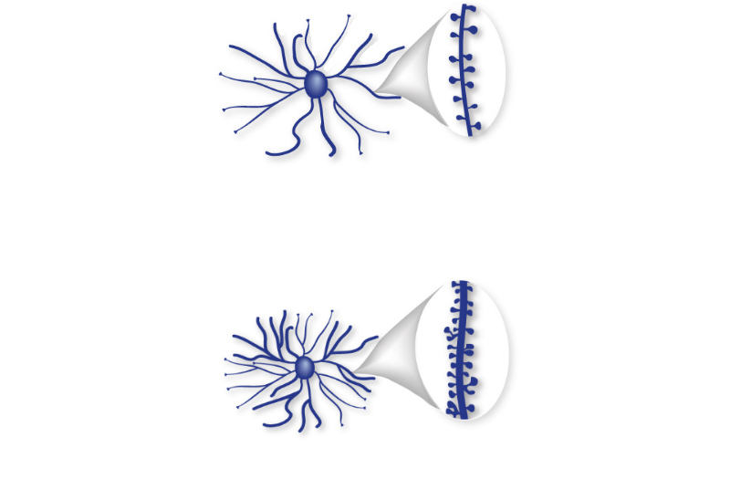
Substance use changes the brain
In some areas, connections between neurons are pruned back. In others, neurons form more connections.
After cocaine use, connections between neurons in the Nucleus Accumbens, part of the reward pathway, increase in number, size, and strength.
Source and Image Credit: The Science of Addiction: Genetics and the Brain, Genetic Science Learning Center. University of Utah 2016
Notes:
In some areas, connections between neurons are pruned back. In others, neurons form more connections.
[CLICK MOUSE]
For example: After cocaine use, connections between neurons in the nucleus accumbens, part of the reward pathway, increase in number, size, and strength.
Once these changes take place, drug-seeking behavior becomes driven by habit, almost reflex.
Source: The Science of Addiction: Genetics and the Brain, Genetic Science Learning Center. 2016. University of Utah. April 2016 http://learn.genetics.utah.edu/content/addiction
ANIMATIONS ARE TIMED TO APPEAR ON-SCREEN WITHOUT NEED TO [CLICK MOUSE]

Slide 61
Brain’s Survival Hierarchy
Brain’s Reward Pathway
#1 Food
Our brain has a survival hierarchy, prioritizing activities that are important for our survival. Drugs and alcohol “fool” the brain that they are important for survival.
#1 Drugs / Alcohol
#2 Food
#2 Water
#3 Water
#3 Sleep
More important than food, water, sleep and interacting with family and friends.
#4 Sleep
#4 Social Interactions
#5 Social Interactions
Source: National Institute on Drug Abuse (NIDA) and The Science of Addiction, University of Utah
Notes:
Our brain has a survival hierarchy, prioritizing activities that are important for our survival.
Drugs and alcohol “fool” the brain that they are important for survival.
[CLICK MOUSE]
More important than food, water, sleep and interacting with family and friends.
When the substance (drug/alcohol) is removed, in time, the brain will rewire or recover.
Sources: National Institute of Drug Abuse: Drugs, Brains, and Behavior: The Science of Addiction, https://www.drugabuse.gov/publications/drugs-brains-behavior-science-addiction/drugs-brain, accessed July 2019and The Science of Addiction: Genetics and the Brain, Genetic Science Learning Center. 2016. University of Utah. April 2016 http://learn.genetics.utah.edu/content/addiction/

Slide 62
section 04 Withdrawal
Copyright, Overdose Lifeline. Inc.
Notes:
This section of the course will look at the effects the body’s withdrawal when the substance is not longer present or available.

Slide 63
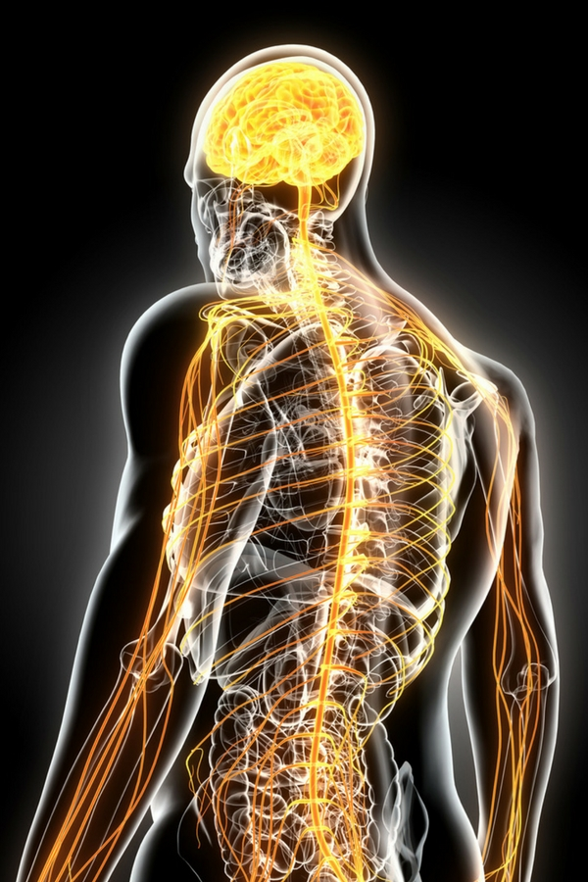
Withdrawal
When the body has become dependent on the substance and the substance is no longer available, withdrawal may occur.
How much and how long one uses determines the SEVERITY of the withdrawal.
Sources: Mentalhealthdaily.com, NLM.NIH.gov, Altamira
Notes:
After repeated use of a substance the neurochemistry of the brain is changed. Withdrawal is what happens when the body has become dependent on the substance and the substance is no longer available.
The severity of withdrawal symptoms depends on how much of the substance has been used and for how long.
Sources: Post Acute Withdrawal Syndrome: Causes, Symptoms, Treatment, Mentalhealthdaily.com, accessed April 2021. Kvarnstrom, Understanding the Differences Between a Hangover and Withdrawal, https://www.altamirarecovery.com/blog/understanding-differences-hangover-withdrawal/, April 2016.

Slide 64
Withdrawal
Age
Other factors include: Age, Physical Condition, Genetics, the Combination of Drugs Used, and the Support Network.
Physical Condition
Genetics
Withdrawal from some substances, such as alcohol, require medical supervision.
Drugs Uses
Support Network
Sources: Mentalhealthdaily.com, NLM.NIH.gov, Altamira
Notes:
Other factors include:
Age, Physical Condition, Genetics, the Combination of Drugs Used, and one’s Support Network.
[CLICK MOUSE]
Withdrawal from some substances, such as alcohol, require medical supervision.
Sources: Post Acute Withdrawal Syndrome: Causes, Symptoms, Treatment, Mentalhealthdaily.com, accessed April 2021. Kvarnstrom, Understanding the Differences Between a Hangover and Withdrawal, https://www.altamirarecovery.com/blog/understanding-differences-hangover-withdrawal/, April 2016.

Slide 65
The Two Stages of Withdrawal
The Acute Stage
The body experiences symptoms of withdrawal
Lasts from a few days to a few weeks
The Post-Acute Stage
Emotional symptoms are experienced
Majority of bodily symptoms end
Episodes last a few days, occurring with increasing gaps in between
Can last up to two years
Sources: Mentalhealthdaily.com, NLM.NIH.gov, Altamira
Notes:
Typically, there are two stages of withdrawal. The Acute stage which lasts a few days to a few weeks, and which encompass physical body symptoms.
And the Post Acute Stage. Led by emotional symptoms such as anxiety, restlessness. Bodily symptoms cease for the most part. Episodes lasting a few days, occurring with increasing gaps between them. Can last up to two years.
Setback rates are greater during both withdrawal stages.
Sources: Post Acute Withdrawal Syndrome: Causes, Symptoms, Treatment, Mentalhealthdaily.com, accessed April 2021. Kvarnstrom, Understanding the Differences Between a Hangover and Withdrawal, https://www.altamirarecovery.com/blog/understanding-differences-hangover-withdrawal/, April 2016.

Slide 66
Treatment
Addiction is a complex but treatable disease that affects brain function and behavior. Treatment needs to be readily available and attend to the multiple needs of the individual. No single treatment is appropriate for everyone.
Group-based peer support – Treatment philosophies vary!
Narcotics Anonymous (NA) /AA
SMART Recovery – Non 12-step
Faith-centered
Recovery housing
Individual-based peer support
School supported
Re-entry programs
Program supported – Human Service Agencies
Peer to peer
Peer Support
Medication
Assisted
Treatment
Counseling
ASAM criteria guide level of care
Outpatient (<9 hrs/week)
High-Intensity Outpatient (9-20 hrs/week)
Partial hospitalization (20-40 hrs/week)
Residential Treatment (Clinically or Medically Managed)
Intensive Inpatient (24-hour nursing and physician care)
Methadone – Mu Opioid Agonist
Buprenorphine –Partial Mu Opioid Agonist
Suboxone/Zubsolv (Sublingual)
Sublocade (28 day injectable)
Naltrexone – Mu Opioid Antagonist
Vivitrol (28 day injectable)

Slide 67
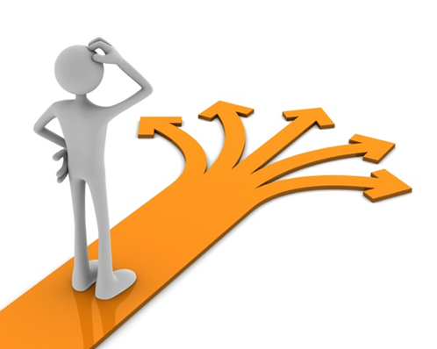
What are the different Levels of Care?
Detox
Youth Detoxification & Stabilization
Residential Treatment (RTC)
Partial Hospitalization Program (PHP)
Intensive Outpatient Program (IOP)
Outpatient Care
Notes:
We know that you work in the residential setting so you’re familiar with what you see on a daily basis, however, this breakdown will help you have a better understanding of the nuances that exist between each LOC. You are encouraged to apply this language to your documentation to support why your client needs that LOC.
5th bullet - Outpatient treatment will not be addressed in this training but it is important to acknowledge this LOC as a step-down from higher levels of care.

Slide 68
section 05 Return to Use or Setback
Copyright, Overdose Lifeline. Inc.
Notes:
In this section we will talk about return to use or setback, which is common with chronic illnesses.

Slide 69
SUD Involves Cycles of Setback & Remission
SUD is progressive and can result in disability or premature death.
A setback (relapse) means a deterioration in someone’s state of health after an improvement.
Alert
Source: National Institute on Drug Abuse
Notes:
Like other chronic diseases, SUD often involves cycles of setback and remission. Without treatment or engagement in recovery activities, SUD is progressive and can result in disability or premature death.
[CLICK MOUSE]
An important note about terminology.
The term Setback is the preferred term rather than relapse, which can carry judgement and stigma.
A setback means a deterioration in someone’s state of health after an improvement
Source: NIH/NIDA, Drugs, Brains, and Behavior: The Science of Addiction, updated July 2018.

Slide 70
Comparison of Setback Rates Between Chronic Illnesses
Percentage of patients who experience a setback
Substance Use Disorder
Hypertension
Asthma
40-60%
50-70%
50-70%
Source: National Institute on Drug Abuse
Notes:
Setback rates, or how often symptoms recur, for people with addiction are similar to rates for other well-understood chronic medical illnesses such as hypertension and asthma.
Source: National Institute on Drug Abuse, McLellan et al., JAMA, 284:1689-1695, 2000.

Slide 71
What does a setback look like?
It can mean a setback in health, thoughts, activities, as well as a return to use.
Does a setback mean that treatment has failed?
No. The chronic nature means that lapsing back to previous disordered behaviors, including use after a period of abstinence,
is not only possible but expected.
Treatment needs to be reinstated or adjusted or other
treatment should be explored.
Source: National Institute on Drug Abuse
Notes:
What does a setback look like? It can mean a setback in health, thoughts, activities. For some people whose goal is abstinence from substance use or use of substances that have become disordered, this can include a return to use.
[CLICK MOUSE]
Does a setback mean that treatment has failed?
No. The chronic nature means that lapsing back to previous disordered behaviors, including use after a period of abstinence, is not only possible but expected"
[CLICK MOUSE]
When this occurs, treatment needs to be reinstated or adjusted or other treatment should be explored.
Source: NIH/National Institute for Drug Abuse: Drugs, Brains, and Behavior: The Science of Addiction, updated July 2018.

Slide 72
section 06 Neuroplasticity
Copyright, Overdose Lifeline. Inc.
Notes:
This section of the course will look at the neuroplasticity of the brain.

Slide 73
Neuroplasticity
(The Brain’s Ability to Change / Reset)
Notes:
Neuroplasticity, can be simply defined as the Brain’s Ability to Change / Reset.

Slide 74
Medical Definition of Neuroplasticity
The brain's ability to reorganize itself in both structure and how it functions by forming new neural connections throughout life.
Neuroplasticity allows the neurons in the brain to compensate for injury and disease and to adjust their activities in response to new situations or to changes in their environment.
For example, if one hemisphere of the brain is damaged, the intact hemisphere may take over some of its functions.
Notes:
A more detailed definition of neuroplasticity is the brain's ability to reorganize itself by forming new neural connections throughout life.
Neuroplasticity allows the neurons (nerve cells) in the brain to compensate for injury and disease and to adjust their activities in response to new situations or to changes in their environment.
[CLICK MOUSE]
For example, if one hemisphere of the brain is damaged, the intact hemisphere may take over some of its functions. The brain compensates for damage in effect by reorganizing and forming new connections between intact neurons.
Source: Marks, Medical Definition of Neuroplasticity, MedicineNet, June, 3 2021.

Slide 75
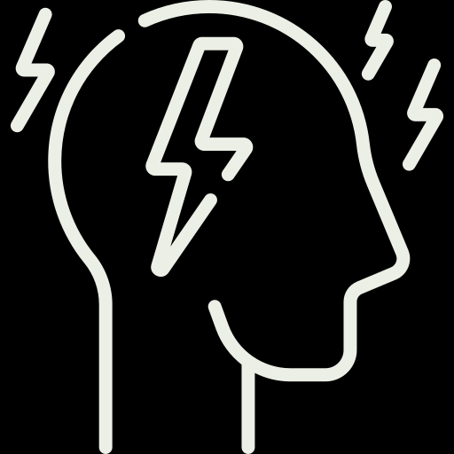
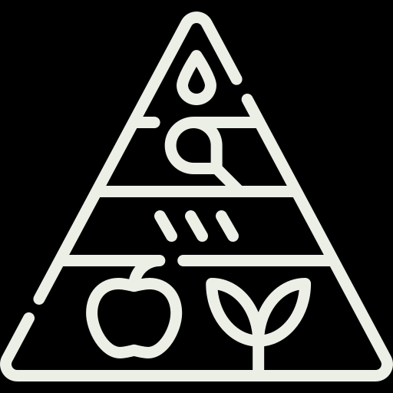
Neuroplasticity can result from
SOCIAL INTERACTIONS
TRAUMA
STRESS
MEDITATION
EMOTIONS
LEARNING
PAYING ATTENTION
DIET
EXERCISE
NEW EXPERIENCES
Source: The National Institute of Clinical Application of Behavioral Medicine (NICABM)
Notes:
In addition to substance use, neuroplasticity can result from
Traumatic Events
Stress
Social Interactions
Meditation
Emotions
Learning
Paying Attention
Diet
Exercise
New Experiences
Source: The National Institute of Clinical Application of Behavioral Medicine (NICABM), How Does Neuroplasticity Work?, Accessed 3/2/2022. https://www.nicabm.com/brain-how-does-neuroplasticity-work/

Slide 76
KEY Points
Neuroplasticity makes our brain resilient. We can learn new ways of being and responding to conflict.
Neuroplasticity enables one to recover from stroke, injury, and birth abnormalities and in many cases overcome depression, SUD, and other issues.
The brain is always learning. It learns whatever is repeated – both helpful and unhelpful thoughts, actions, and habits.
Source: The National Institute of Clinical Application of Behavioral Medicine (NICABM)
Notes:
A few key points to keep in mind regarding neuroplasticity.
Neuroplasticity makes our brain resilient. We can learn new ways of being and responding to conflict.
Neuroplasticity enables one to recover from stroke, injury, and birth abnormalities. In many cases overcome depression, SUD, and other issues.
The brain is always learning. It learns whatever is repeated – both helpful and unhelpful thoughts, actions, and habits.
Source: The National Institute of Clinical Application of Behavioral Medicine (NICABM), How Does Neuroplasticity Work?, Accessed 3/2/2022. https://www.nicabm.com/brain-how-does-neuroplasticity-work/

Slide 77
With SUD, the affected brain has remapped itself to make feeding the addiction the most natural and most important course of action.
Before
After
Source: National Institute on Drug Abuse (NIDA)
Notes:
In addiction, the brain has learned or remapped itself to make feeding the addiction the most natural and most important course of action.
Source: National Institute of Health (NIH), O’Brien, Neuroplasticity in addictive disorders, September 2009

Slide 78
Our brains have the power to change
With hard work, individualized addiction treatment that addresses the whole individual - recovery is possible.
Before
After
Reset
Source: National Institute on Drug Abuse (NIDA)
Notes:
Our brains have the power to change, undo the remapping. With hard work, individualized addiction treatment that addresses the whole individual - recovery is possible.
Source: National Institute of Health (NIH), O’Brien, Neuroplasticity in addictive disorders, September 2009
ANIMATIONS ARE TIMED TO APPEAR ON-SCREEN WITHOUT NEED TO [CLICK MOUSE]

Slide 79
“While neuroplasticity may be a culprit in the creation of addiction, it also holds the key to recovery. By harnessing the moldability of the brain and abandoning the neural connections fed by addictive behaviors, new pathways can be formed via the development of healthy behaviors and thought processes.“
Source: Altamira The Brain that Heals Itself, June 2015
Notes:
“While neuroplasticity may be a culprit in the creation of addiction, it also holds the key to recovery. By harnessing the moldability of the brain and abandoning the neural connections fed by addictive behaviors, new pathways can be formed via the development of healthy behaviors and thought processes.“
Source: Kvarnstrom, The Brain That Heals Itself: Neuroplasticity and Promise for Addiction Treatment, https://www.altamirarecovery.com/blog/the‐brain‐that‐heals‐itself‐neuroplasticity‐and‐
promise‐for‐addiction‐treatment, June 2015.

Slide 80
Notes:
What do these cows have to do with neuroplasticity?
A herd of cows will “create” a “walking path” from the pasture - back to the barn. In time as they repeatedly walk along this same path in the field each and every day the path gets deeper.
They will habitually continue to walk this path, deepening the rut.
However, they can be redirected to a new route. A new habit is created.
And in time the old path changes from a deep dirt groove to become grass covered again (it is reset)

Slide 81
One Pill can Kill
https://www.youtube.com/watch?v=C1BgXlYwoVY

Slide 82
Neil Gaer, MPA, LADC ngaer@me.com 860 324-9313 https://www.linkedin.com/in/ngaer/

Slide 83
Visit OverdoseLifeline.org Advocacy – Education – Support – Resources
Notes:
This has been brought to you by Overdose Lifeline, Inc. a nonprofit dedicated to helping individuals, families and communities affected by the disease of addiction / substance use disorder.
Overdose Lifeline addresses the opioid epidemic and the chronic disease of addiction through advocacy, education, and support.
Please visit Overdose Lifeline website at overdoselifeline.org

